Slide 1
Building The Worst Linux PC Ever
Mohammad Mazarei
Notes:
ID=d924773e-9a16-4d6d-9803-8cb819e99682
Recipe=text_billboard
Type=TextOnly
Variant=0
FamilyID=AccentBoxWalbaum_Zero
22

Slide 2


Introduction
I am an Electronic and Embedded System Engineer with over 10 years of professional experience.
Have been in contact with exciting topics such as Electronics, Programming (mainly for Hardware) Embedded Linux, Real-time operating systems, Embedded systems, Sensors and telecommunication networks, IoT devices, etc
and co-founder of sisoog.com

Slide 3


What is Sisoog
Sisoog is the name of a bird that lives in Iran and is known for freedom. Local people believe it is impossible to keep this bird in a cage.
Since electronic science is so limitless(endless) and developing so fast, we must not fall behind. We believe that Sisoog is an electronic science sharing wisdom so our aim is to improve acknowledgment and efficiency.

Slide 4

Contents
What does Linux need to boot
What is Microcontroller
Why Linux can not Directly boot from micro
How to boot Linux on a Microcontroller
Build the Worst Linux PC
<number>

Slide 5

What does Linux need to boot?

Slide 6
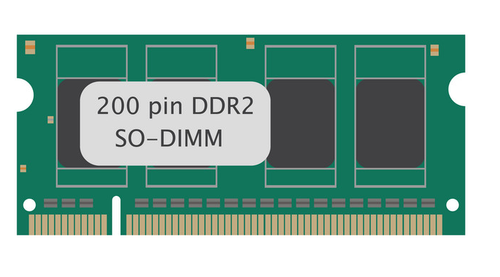
A lot of RAM
Linux Kernel extracting into RAM
Init-FS extracting into RAM
Linux uses a lot of caching.
Each program needs its own memory space
<number>

Slide 7

A lot of Disk
Compress Kernel store in disk
Compress init-FS store in disk
All program store in disk
All Setting store in disk
<number>

Slide 8
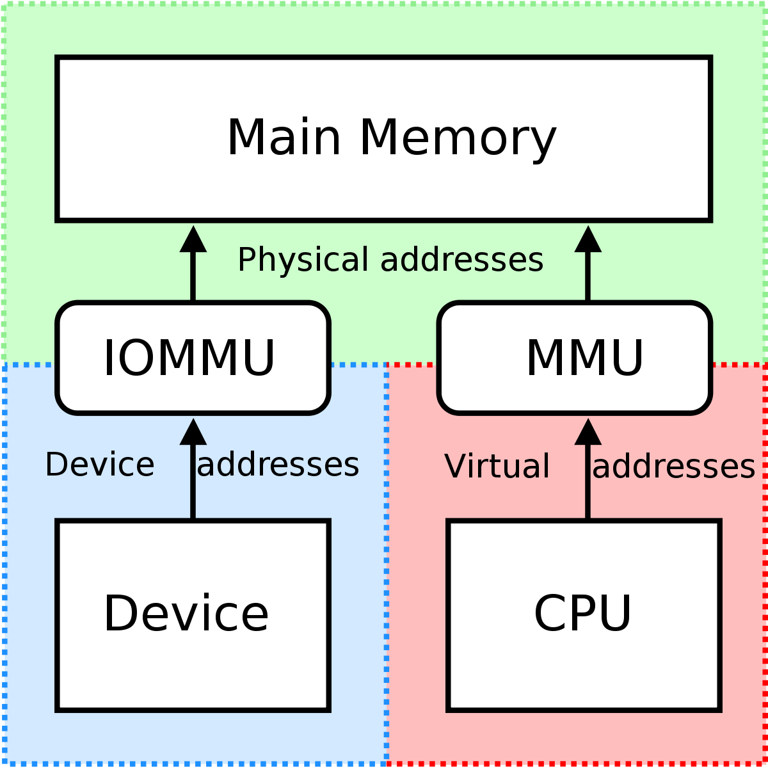
Memory Management Unit (MMU)
A memory management unit (MMU) is a hardware component that manages the allocation and use of memory.
Memory protection
Memory sharing
Virtual memory
<number>

Slide 9
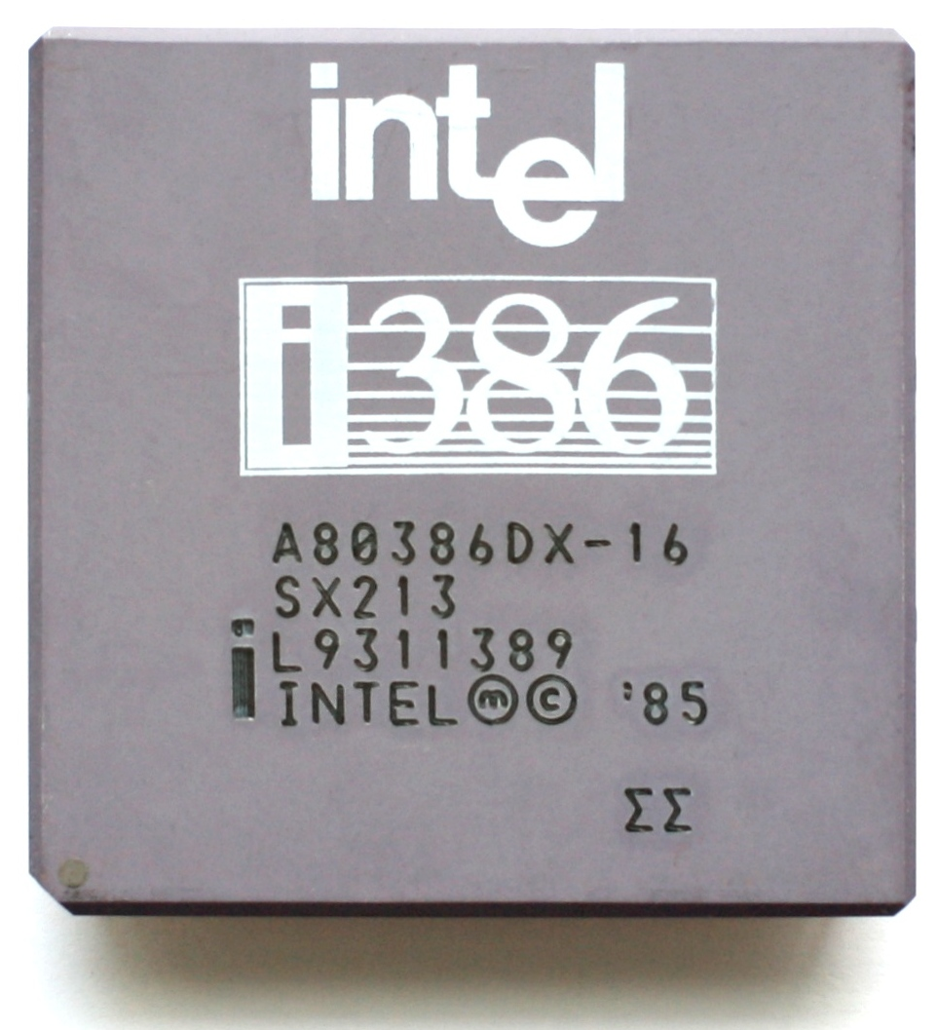
Powerful 32bit Processor
Linus Torvalds started writing Linux for their 80360 PC in 1991.
Today, Linux runs on a wide variety of processors, including Intel, AMD, ARM, and PowerPC.
All processors have a 32-bit structure!
<number>

Slide 10
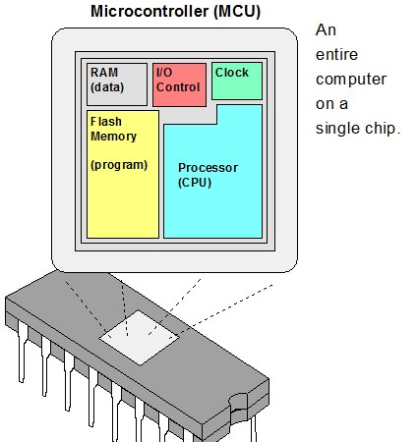
What is Microcontroller

Slide 11
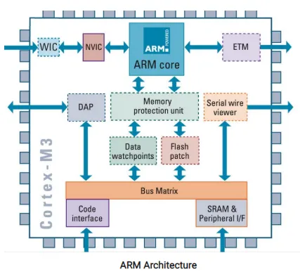
What is MCU
A Microcontroller is a small, low-cost
Computer on a single integrated circuit.
It contains a CPU, RAM, ROM,
and I/O peripherals.
Microcontrollers are typically used in
embedded systems
<number>

Slide 12
Properties of MCU
Small size: MCUs are typically very small and lightweight
low power:They also consume very little power
Low cost:MCUs are relatively inexpensive to produce
On-chip memory: MCUs typically have a small amount of on-chip memory
Clock speed: MCUs typically have a lower clock speed than desktop
No MMU: Not all MCUs have MMUs. MMUs are more commonly found in higher-end MCUs and MPUs
<number>

Slide 13

Linux Can Boot With Out MMU
uClinux (Microcontroller Linux) is a lightweight version of the Linux kernel that is designed for Microcontrollers and other embedded systems.
uClinux was first developed in 1996 by Linus Torvalds and Richard Stallman. It is based on the Linux kernel.
It is small and efficient, making it ideal for embedded systems.
It is free and open-source, which means that anyone can use it.
It is very flexible and can be adapted to a wide variety of hardware.
It is very portable and can be compiled for different architectures.
<number>

Slide 14
Why we don’t use uClinux
uClinux Only supports 32-bit CPU
and No longer supported
<number>

Slide 15

How to boot Linux on Microcontroller
So what do we do now?
<number>

Slide 16
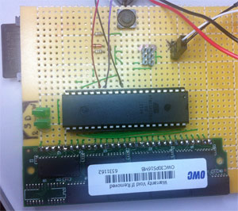
Linux on an 8-bit Microcontroller
A long long time ago (in 2012) Dmitry ran Linux on an 8-bit AVR
Dmitry wrote a 32-bit ARM CPU emulator with MMU and SD with 16MB SDRAM
The main problem was that it was too slow. The effective speed was 10KHz, the boot time was 6 hours
16

Slide 17
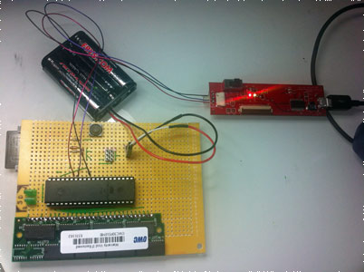
Details on the uARM emulator
The board you see on the right is based on an ATmega1284p.This board features no other processor and boots Linux 2.6.34. In fact, it can even bring up a full Ubuntu stack, including (if you have the time) X and gnome.
uArm Emulate ARMv5TE core
uArm Support SDRAM as bitbanging
uArm Emulate MMU
uArm Can Run Thumb instructions
uArm implements an i-cache to speed things up
16

Slide 18
How to boot Linux on Microcontroller
Can we boot Linux
on a weaker system?
16

Slide 19
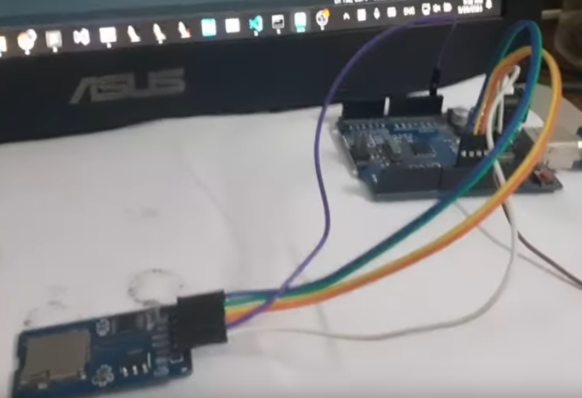
Linux on an 8-bit uC without ram
arv32-opt port of mini-rv32ima (a minimum RISC-V emulator, capable of booting Linux) on atmega328p
emulator's RAM is accessed via swapping with an SD card also has three 512-byte cache,1 Icache, and 2 Dcache
most of the time 700Hz, peak 1500Hz, lowest 70Hz, Complete boot time (from start to shell) is about 15 hours and 44 minutes
19

Slide 20
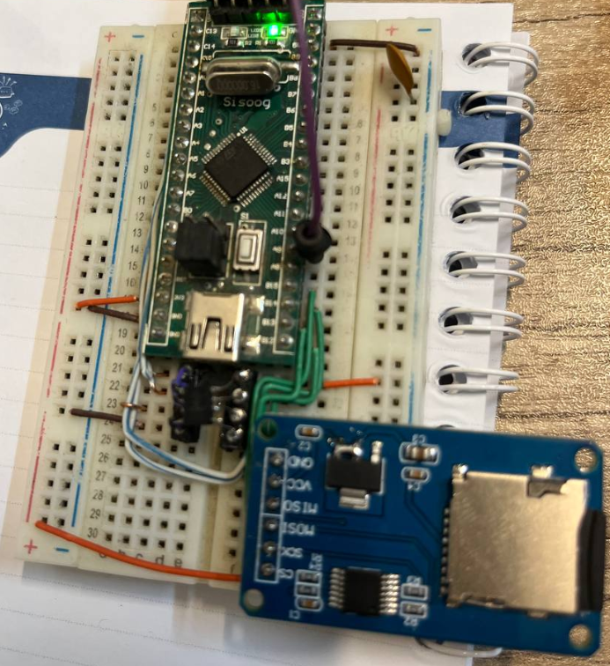
Usable Linux on MCU
I wanted the new design to be speedy enough to boot in a few minutes and reply to commands in seconds
I wanted it to be easy to assemble for anyone. This meant no components with tight spacing, no components with too many pins
A part of this wish was also that someone could assemble one
20

Slide 21
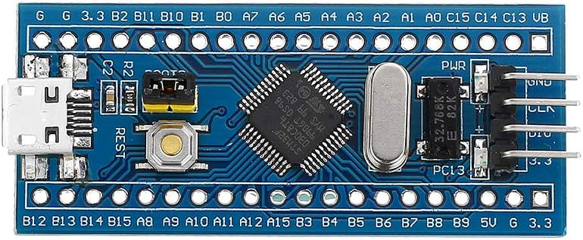
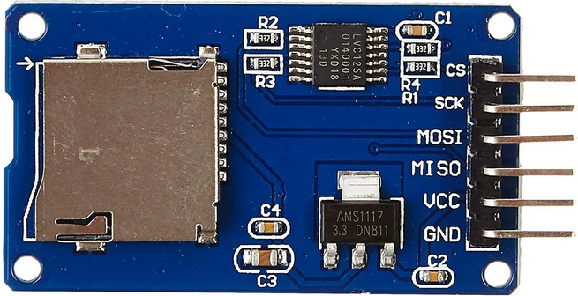
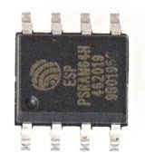
Usable Linux on MCU
I use Blue-Pill, it is a low-cost, open-source development board based on the STM32F103C8T6
For storage, Micro-SD is perfect (easy to interface with, widely available, cheap)
I use a cool thing called PSRAM. It is basically DRAM, but in easy mode
21

Slide 22
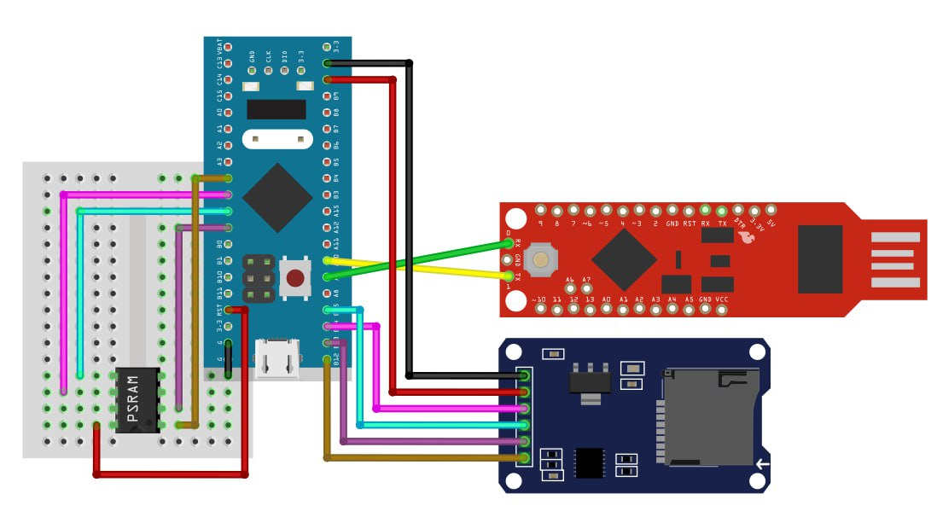
Hardware is very simple
Microcontroller
USB to Serial
Micro-SD
PSRAM
22

Slide 23
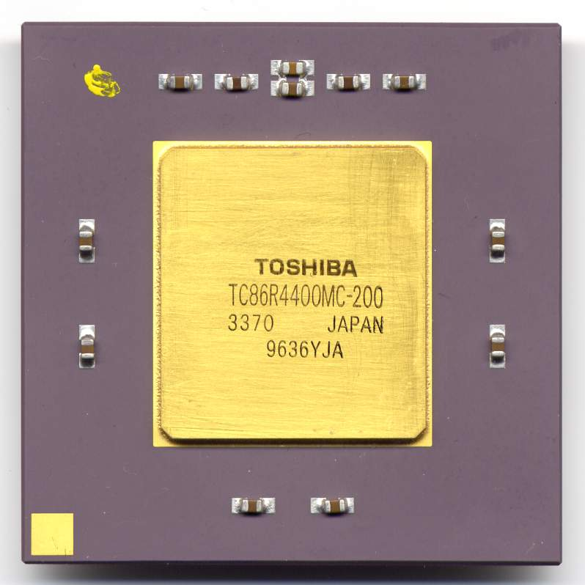
Usable Linux on MCU
The ideal emulation target will
be a RISC chip
have no condition codes (like MIPS)
be 32-bit since 16-bit machines are all funky
have a workable set of GNU tools and Linux
22

Slide 24
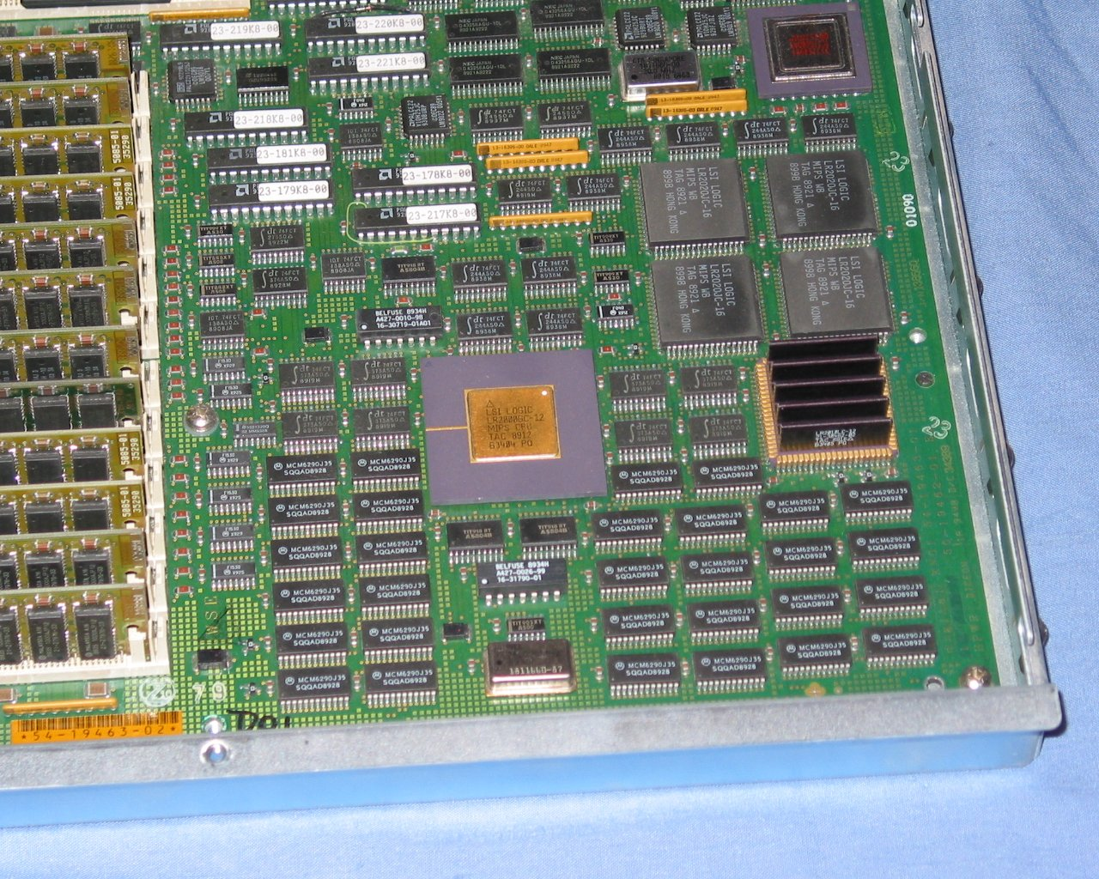
A MIPS primer
MIPS is old but one of the original RISC designs.
If you are a RISC-V fanboy(/girl), MIPS will look familiar - it is where 99.9994% of the initial RISC-V spec was copied from.
We can write MIPS-I emulator in under 1000 lines of C code
MIPS R2000/R3000 is a processor
We emulate the DECstation2100 system
22

Slide 25
emulate DECstation2100
To emulate DECstation2100 we need emulate all hardware parts.
uMips emulator use 12k Ram
uMips emulator use 42k Rom
LINUX OS
MIPS CPU
MMU
FPU
SCSI
RTC
BIOS
Blue-Pill HW (Cortex-M3 Run @128Mhz)
PSRAM(8MB)
SD card
22

Slide 26
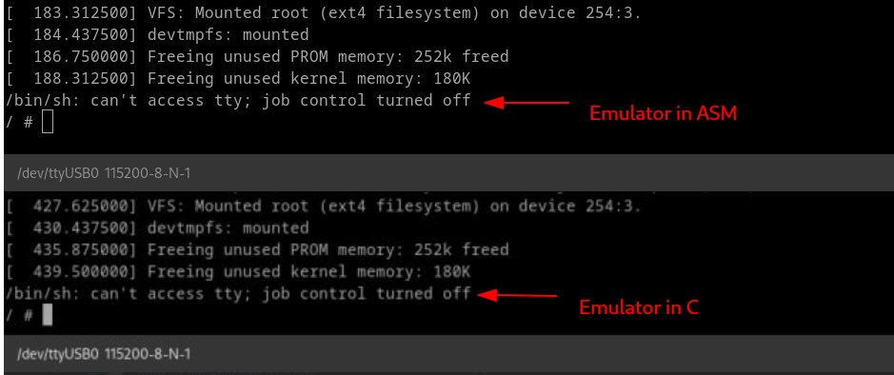
CPU Performance in C and ASM
188sec
439sec
22

Slide 27
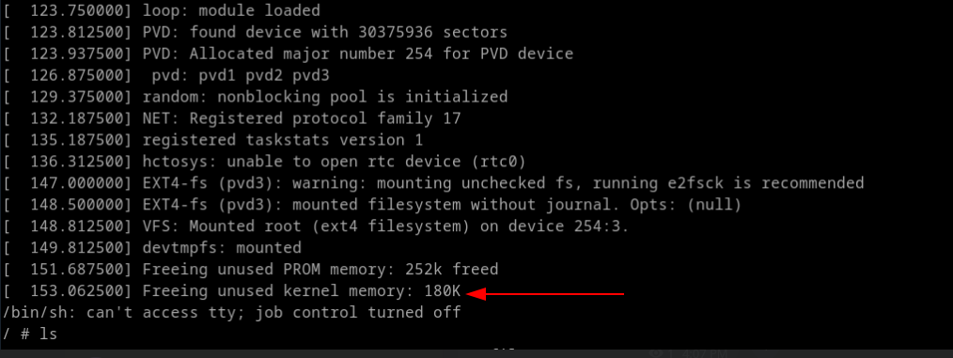
Add CPU Icache
153sec
22

Slide 28
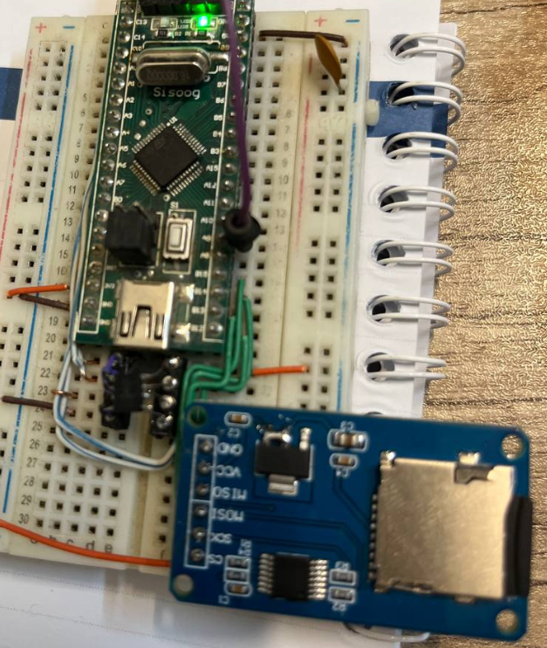
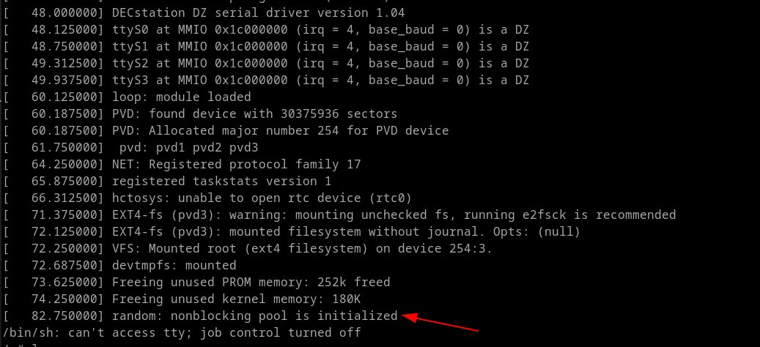
Over Clock Blue Pill to 128Mhz
82sec
22

Slide 29




Thank you
Twitter.com/sisoog
t.me/sisoog
zeus@sisoog.com
Github uLinux
Sisoog.com
22

